Slide 1

CSE 473
Pattern Recognition

Slide 2
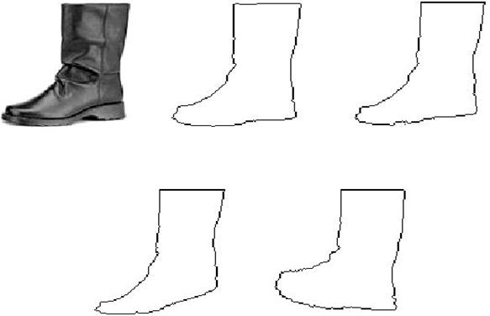
Template Matching

Slide 3
Template Matching
Typical Applications
  Speech Recognition
  Motion Estimation in Video Coding
  Data Base Image Retrieval
  Written Word Recognition
  Bioinformatics

Slide 4
Template Matching
The Goal:
  Given a set of reference patterns known as TEMPLATES,
  find the best match for unknown pattern
  each class represented by a single typical pattern.
requires an appropriate “measure” to quantify similarity or matching.

Slide 5
Template Matching
The cost “measure”:
  deviations between the template and the test pattern.

Slide 6
Template Matching
The cost “measure”:
  deviations between the template and the test pattern.
  For example:
    The word beauty may have been read as beeauty or beuty, etc., due to errors.
    The same person may speak the same word differently.

Slide 7
Template Matching Methods
Optimal path searching techniques
Correlation
Deformable models

Slide 8


TM using Optimal Path Searching
Representation: Represent the template by a sequence of measurement vectors or string patterns
  Template:
  Test pattern:

Slide 9

TM using Optimal Path Searching
  Template:
  Test pattern:
In general
We need to find an appropriate distance measure between test and reference patterns.

Slide 10
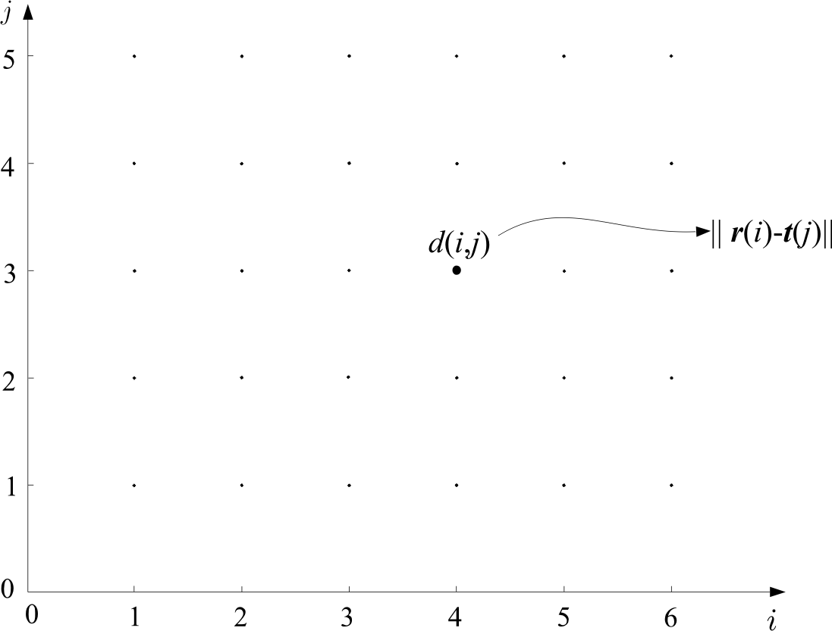
TM using Optimal Path Searching
  Form a grid with I points (template) in horizontal and J points (test) in vertical
  Each point (i,j) of the grid measures the distance between r(i) and t(j)

Slide 11
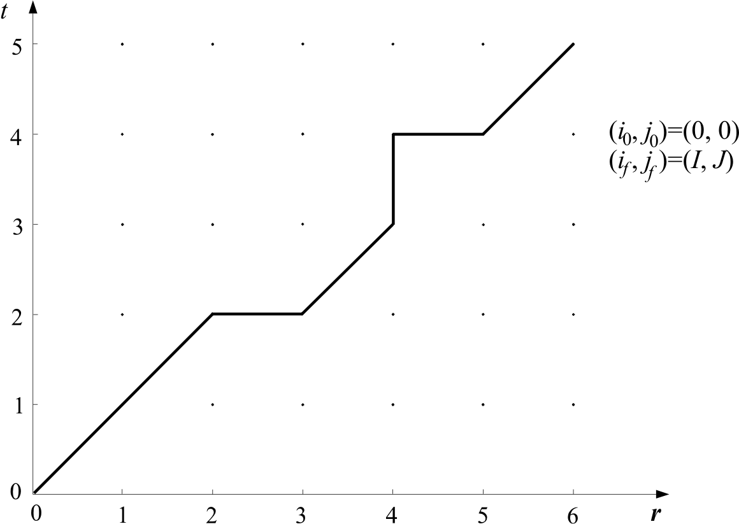
TM using Optimal Path Searching
  Path: A path through the grid, from an initial node
  (i₀, j₀) to a final one (i_{f}, j_{f}), is an ordered set of nodes
  (i₀, j₀), (i₁, j₁), (i₂, j₂) … (i_{k}, j_{k}) … (i_{f}, j_{f})

Slide 12



TM using Optimal Path Searching
  Path: A path is complete path if:

Slide 13
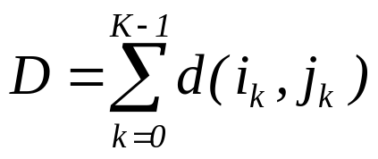
TM using Optimal Path Searching
  Each path is associated with a cost
  where K is the number of nodes across the path

Slide 14

TM using Optimal Path Searching
Let the cost up to node (i_{k}, j_{k}) be
By convention
  D(0, 0)=0
  d(0,0)=0

Slide 15
TM using Optimal Path Searching
The equation
assumes that each node has been associated with some cost

Slide 16

TM using Optimal Path Searching
The equation
assumes that each node has been associated with some cost
However, each transition (i_{k-1}, j_{k-1}) to (i_{k}, j_{k}) may also associate with a cost
The new equation is:

Slide 17


TM using Optimal Path Searching
  Search for the path with the optimal cost D_{opt.}
  The matching cost between template and test pattern is D_{opt.}
  Costly operation
  Needs efficient computation

Slide 18
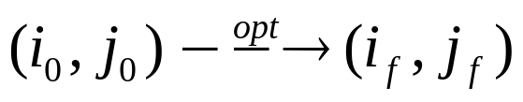
Bellman’s Optimality Principle
Optimal path:

Slide 19
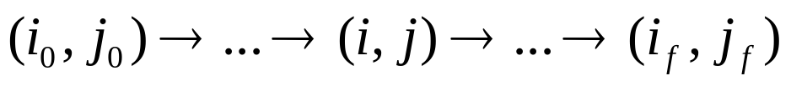
Bellman’s Optimality Principle
Optimal path:
Let (i,j) be an intermediate node, i.e.

Slide 20
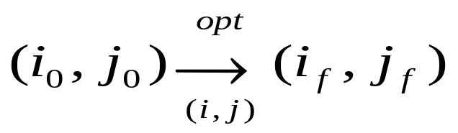
Bellman’s Optimality Principle
Optimal path:
Let (i,j) be an intermediate node, i.e.
Then, write the optimal path through (i, j)

Slide 21
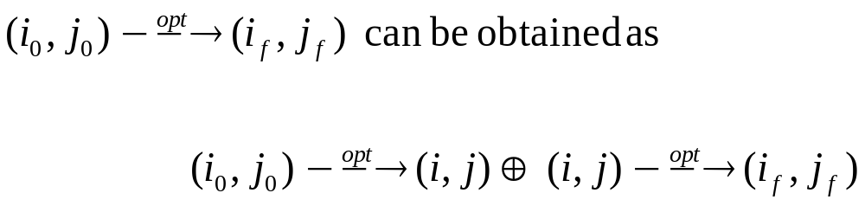
Bellman’s Optimality Principle
Bellman’s Principle:
meaning: The overall optimal path from (i₀,j₀) to (i_{f},j_{f}) through (i,j) is the concatenation of the optimal paths from (i₀,j₀) to (i,j) and from (i,j) to (i_{f},j_{f})

Slide 22
Bellman’s Optimality Principle
Bellman’s Principle:
Let D_{opt.} (i_{k-1} ,j_{k-1}) is the optimal path to reach (i_{k-1} ,j_{k-1}) from (i₀,j₀), then Bellman’s principle is stated as:

Slide 23
Bellman’s Optimality Principle
We don’t need to search the whole space to find the optimal path
Global and local constraints may be imposed to reduce the search space

Slide 24
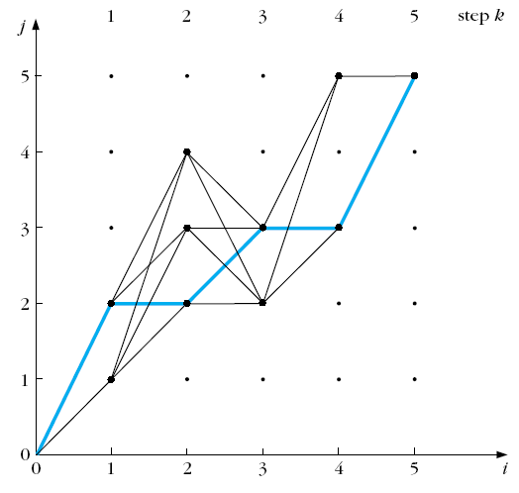
Bellman’s Optimality Principle
We don’t need to search the whole space to find the optimal path
Global and local constraints may be imposed to reduce the search space

Slide 25
Application of TM in Text Matching:
The Edit Distance
The Edit distance
  It is used for matching written words. Applications:
    Automatic Editing
    Text Retrieval

Slide 26
Application of TM in Text Matching:
The Edit Distance
The Edit distance
  It is used for matching written words. Applications:
    Automatic Editing
    Text Retrieval
  The measure to be adopted for matching, must take into account:
    Wrongly identified symbols
    e.g. “befuty” instead of “beauty”
    Insertion errors, e.g. “bearuty”
    Deletion errors, e.g. “beuty”

Slide 27
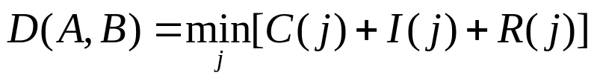
The Edit Distance
Edit distance: Minimal total number of changes, C, insertions I and deletions R, required to change pattern A into pattern B,
where j runs over All possible variations of symbols, in order to convert A B

Slide 28
The Edit Distance
Edit distance: Minimal total number of changes, C, insertions I and deletions R, required to change pattern A into pattern B,
where j runs over All possible variations of symbols, in order to convert A B
Example: many ways to change beuty to beauty

Slide 29
The Edit Distance
The optimal path search algorithm can be used, provided we know
  Initial conditions
  Search space
  Allowable transitions
  Distance measure

Slide 30

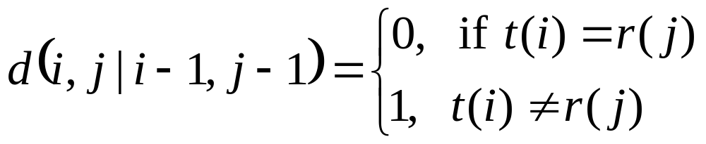
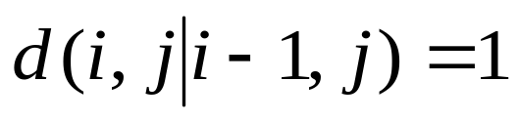
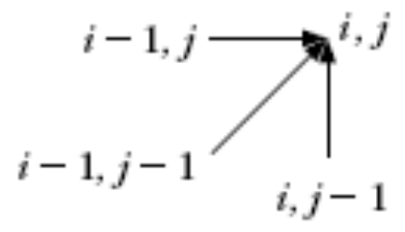
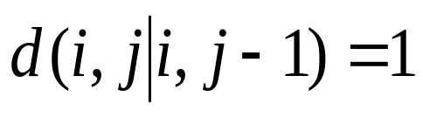
The Edit Distance
Cost D(0,0) = 0,
Complete path is searched
Allowable predecessors and costs:
  Horizontal
  Vertical

Slide 31
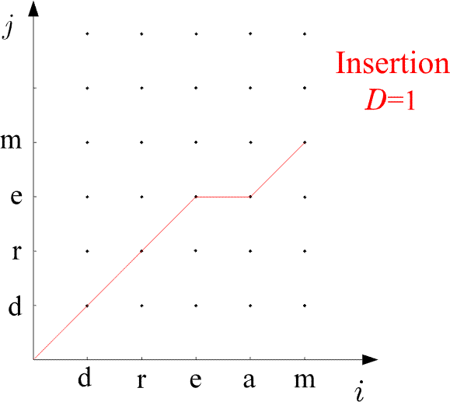
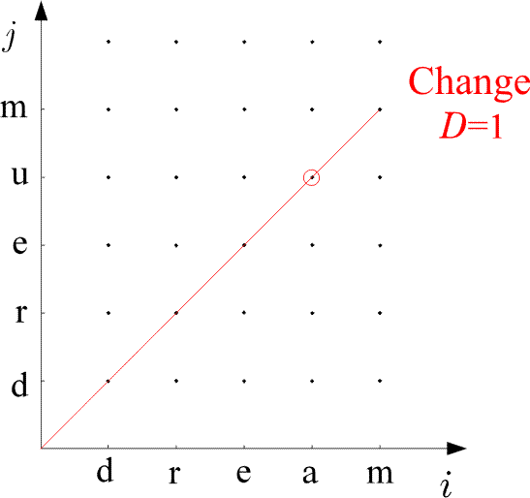
Examples:

Slide 32
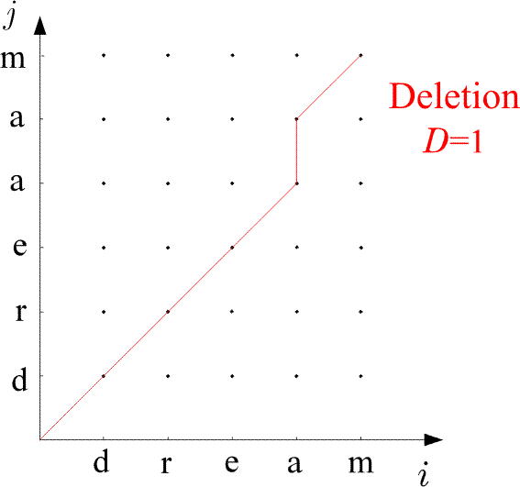
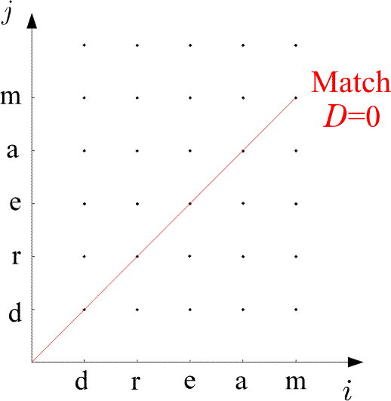
Examples:

Slide 33
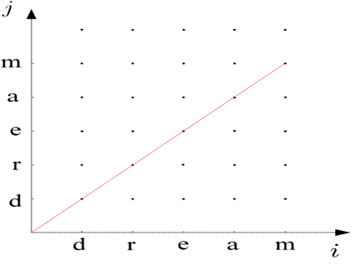
The Edit Distance
The Algorithm
  D(0,0)=0
  For i=1, to I
    D(i,0)=D(i-1,0)+1
  END {FOR}
  For j=1 to J
    D(0,j)=D(0,j-1)+1
  END{FOR}
  For i=1 to I
    For j=1, to J
      C₁=D(i-1,j-1)+d(i,j ׀ i-1,j-1)
      C₂=D(i-1,j)+1
      C₃=D(i,j-1)+1
      D(i,j)=min (C₁,C₂,C₃)
    END {FOR}
  END {FOR}
  D(A,B)=D(I,J)

Slide 34
Application of TM in Speech Recognition
A number of variations
  Speaker Independent Speech Recognition
  Speaker Dependent Speech Recognition
  Continuous Speech Recognition
  Isolated word recognition (IWR)

Slide 35
Application of TM in IWR
The goal:
  Given a number of known spoken words in a data base (reference patterns)
  find the best match of an unknown spoken word (test pattern).
Procedure:
  compare the test word against reference words

Slide 36
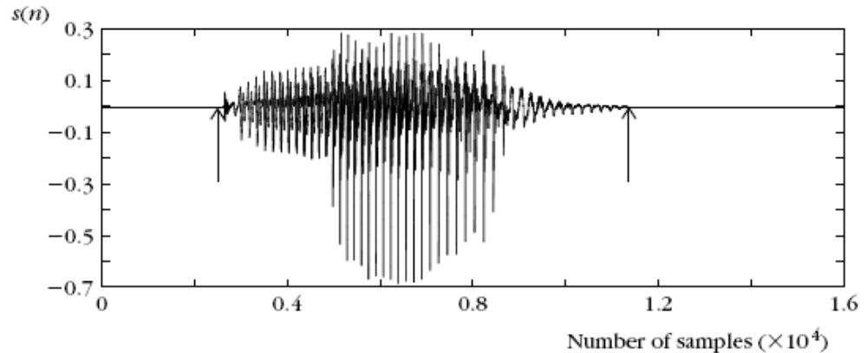
Application of TM in IWR

Slide 37
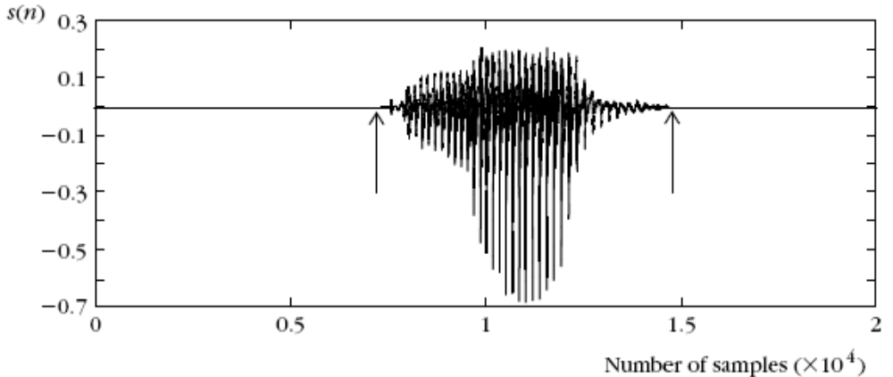
Application of TM in IWR

Slide 38


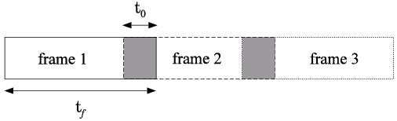
Application of TM in IWR
The procedure:
  Express the test and each of the reference patterns as sequences of feature vectors , , .
  To this end, divide each of the speech segments in a number of successive frames.

Slide 39
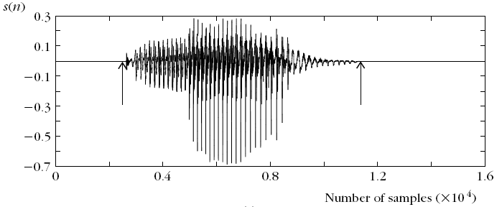
Application of TM in IWR
The procedure:
  Sample a speech segment from a microphone:

Slide 40
Application of TM in IWR
The procedure:
t_{f} = 512
t₀ = 100
Frame 1
Frame 2
Frame 2

Slide 41
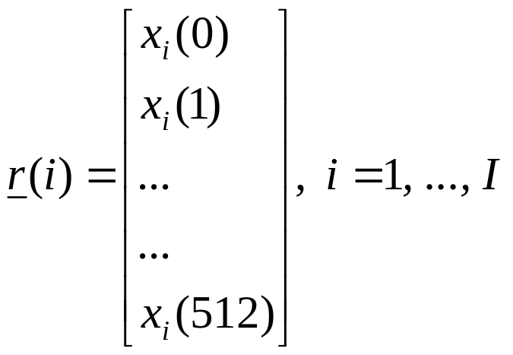
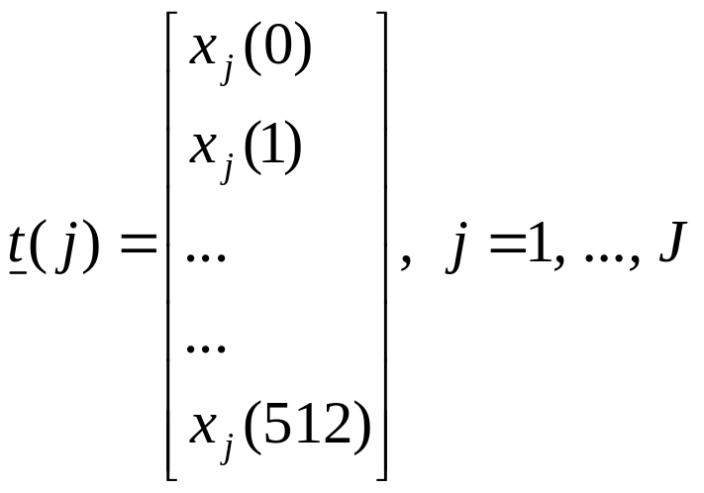
each frame is represented by a vector of 512 samples

Slide 42
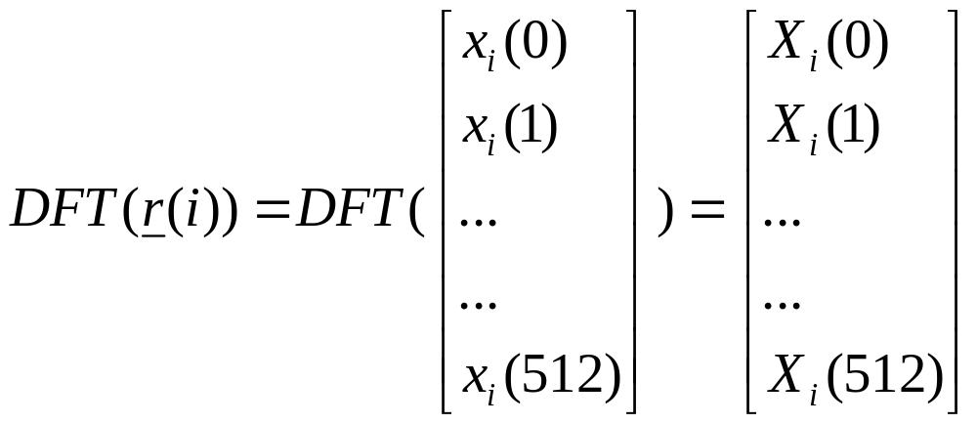

convert them to DFT

Slide 43
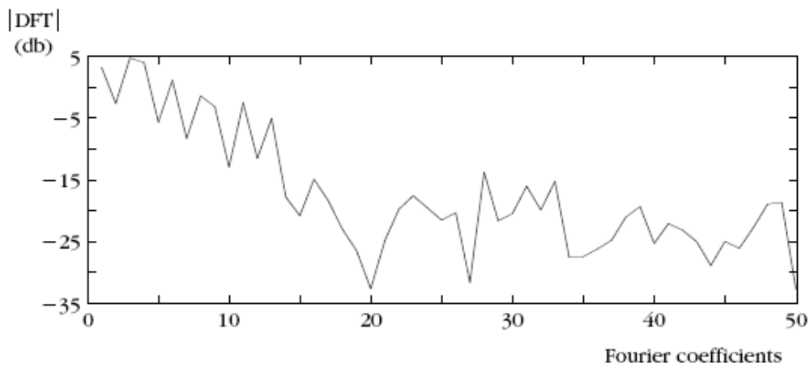
convert them to DFT

Slide 44
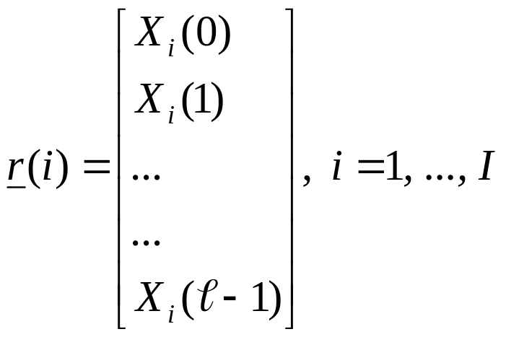
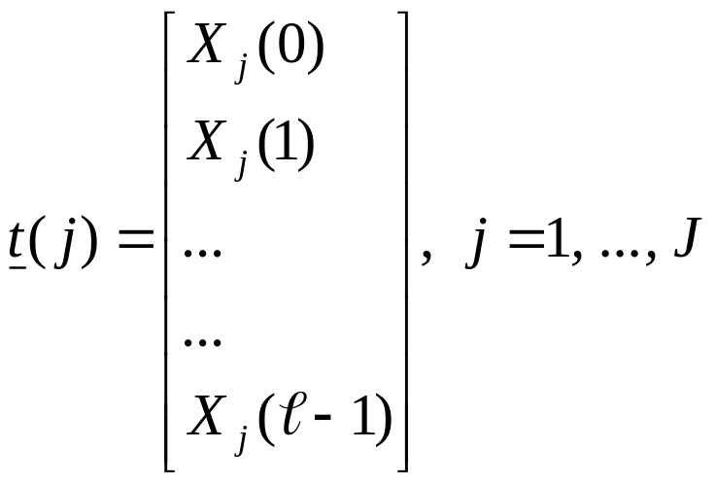
    For each frame compute a feature vector. For example, the DFT coefficients and use, say, ℓ of those:

Slide 45
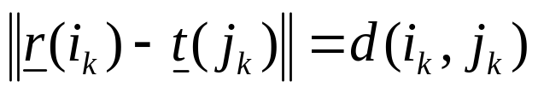
    For each frame compute a feature vector. For example, the DFT coefficients and use, say, ℓ of those:
    Choοse a cost function associated with each node across a path, e.g., the Euclidean distance

Slide 46
    For each frame compute a feature vector. For example, the DFT coefficients and use, say, ℓ of those:
    Choοse a cost function associated with each node across a path, e.g., the Euclidean distance
    find the optimal path in the grid
    Match the test pattern to the reference pattern associated with the optimal path

Slide 47
  Prior to performing the math one has to choose:
    end point constraints
    global constraints
    local constraints
    distance

Slide 48
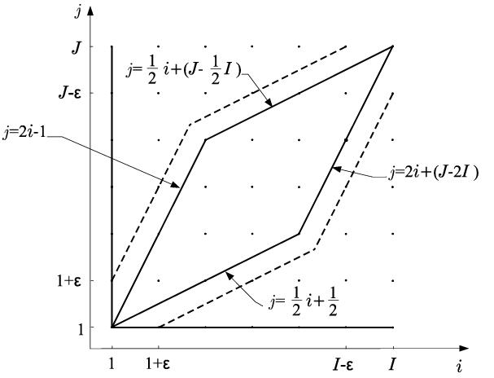
  Prior to performing the math one has to choose:
    The global constraints: Defining the region of space within which the search for the optimal path will be performed.

Slide 49

    The local constraints: monotonic path

Slide 50
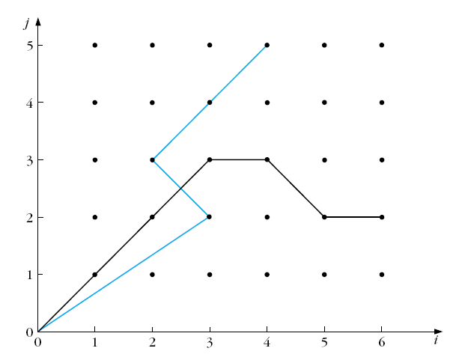
    The local constraints: monotonic path
    Non-monotonic path

Slide 51
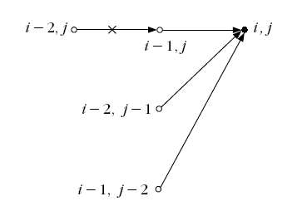
    The local constraints: Defining the type of transitions allowed between the nodes of the grid.
    Itakura local constraints

Slide 52
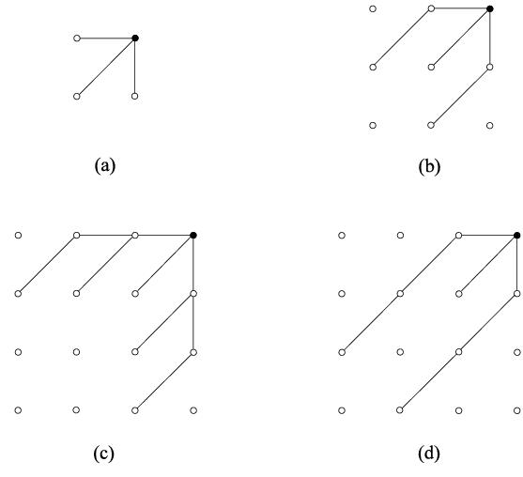
    The local constraints: Defining the type of transitions allowed between the nodes of the grid.
Sakoe and Chiba local constraints

Slide 53
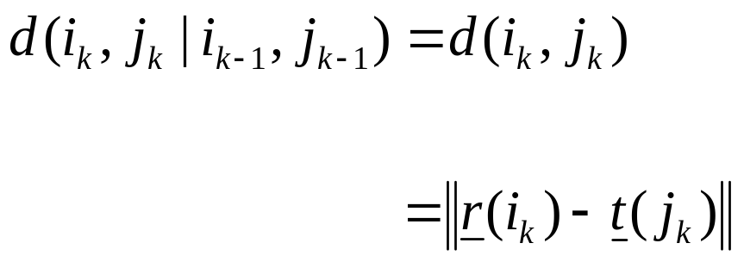
    cost function:
      Euclidean distance
      only node distance

